Slide 1

Oklahoma Higher Education Employee Interlocal
Blue Cross and Blue Shield of Oklahoma, a Division of Health Care Service Corporation, a Mutual Legal Reserve Company, an Independent Licensee of the Blue Cross and Blue Shield Association
Group Retiree Medicare Solutions

Slide 2
Health Plan Overview
Medicare Basics and Plan Details
Premiums and Important Reminders
Questions
Welcome & Agenda

Slide 3

ABCs of Medicare
Blue Cross and Blue Shield of Illinois, a Division of Health Care Service Corporation, a Mutual Legal Reserve Company, an Independent Licensee of the Blue Cross and Blue Shield Association

Slide 4


A
Part A Hospital Insurance/ Original Medicare
HELPS COVER
Inpatient care in hospitals
Skilled nursing facility care
Hospice care
Home health care
While most Americans are enrolled automatically in Medicare Part A, it alone may not cover all health care costs. Parts B, C, and D are voluntary programs that provide additional coverage.

Slide 5

A
B
Part B Medical Insurance/ Original Medicare
HELPS COVER
Services from doctors and other health care providers
Outpatient care
Durable medical equipment (such as wheelchairs, walkers, hospital beds, and other equipment and supplies)
Many preventive services (such as screenings, shots, and yearly wellness visits)
If you don’t enroll in Part B when you are first eligible for Medicare, you may have to pay a penalty later.
A
B
B

Slide 6

B
A
C
Part C Medicare Advantage Plan
Option where members can enroll in a private health plan
Part C is an alternative to Original Medicare (Parts A+B) and may or may not cover prescription drugs
A
B
B

Slide 7

B
A
C
D
Part D Prescription Drug Coverage
HELPS COVER
Outpatient prescription drugs, through private plans that contract with Medicare
If you don’t enroll in Part D when you are first eligible for Medicare, you may have to pay a penalty later.
A
B
B

Slide 8
Plan Details
Blue Cross and Blue Shield of Illinois, a Division of Health Care Service Corporation, a Mutual Legal Reserve Company, an Independent Licensee of the Blue Cross and Blue Shield Association

Slide 9
Blue Cross Group Medicare AdvantageSM (MA) Plan Highlights
Medical Coverage​
Annual Deductible ​ | $0 Deductible​
Out-of-Pocket Maximum​ | $0 Out-of-Pocket Maximum​
Primary Care Office Visit​ | $0 copay​
Specialist Care Office Visit​ | $0 copay​
Inpatient Hospital Services​ | $0 copay per day (days 1-7)​
Outpatient Hospital Services​ | $0 copay​
Emergency Care (worldwide)​ | $0 copay​
Urgent Care​ | $0 copay​
Physical, Speech & Occupational Services​ | $0 copay​
Ambulance Services​ | $0 copay​
Skilled Nursing​ | $0 copay (days 1-20)​
Cardiac Rehabilitation Services | $0 copay Maximum of 2 one-hour sessions per day up to 36 sessions in 36 weeks. Limit to 36 per year.

Slide 10
Blue Cross Group Medicare AdvantageSM (MA) Plan Highlights
Supplemental Benefits​
Hearing Services – Routine Hearing Exam | $0 copay​
Hearing Services – Hearing Aids | $500 hearing aid allowance for both ears combined, every 3 years
Routine Podiatry Services | $0 copay (6 visits per year)
24/7 Nurseline ​ | $0 copay​
Silver Sneakers ​ ​ | $0 copay​
Blue 365 (discount platform)​ ​ | $0 copay ​
In Home Health Evaluations by Signify ​ | $0 copay​
Member Rewards Program by Healthmine​ | Up to $100 per year​

Slide 11
Blue Cross Group Medicare Rx (PDP)SM Highlights – High and Low Plans Compared
 | High Plan | Low Plan
Deductible​ | No Deductible​ | $615
Copay/Coinsurance​ | Same copays/coinsurance during ​ Initial Coverage Limit and Coverage Gap​ | Same copays/coinsurance during ​ Initial Coverage Limit and Coverage Gap​
Pharmacy Out-of-Pocket Maximum​ | $2,100 | $2,100
Mail Order Program​ | Mail Order Program Included​ | Mail Order Program Included​
Pharmacy Access​ | Access to 63,000+ Pharmacies​ | Access to 63,000+ Pharmacies​

Slide 12
Blue Cross Group Medicare Rx (PDP)SM Highlights – High and Low Plans Compared
Formulary Name: 5 Tier Complete
30-Day Supply – Retail Pharmacy | High Plan | Low Plan
Tier 1 – Preferred Generic​ | $10 copay​ | 25% coinsurance
Tier 2 – Non-Preferred Generic​ | $10 copay​ | 25% coinsurance
Tier 3 – Preferred Brand​ | 25% coinsurance $45 max | 25% coinsurance
Tier 4 – Non-Preferred Drug​ | 50% coinsurance $95 max | 25% coinsurance
Tier 5 – Specialty​ | 50% coinsurance $95 max | 25% coinsurance

Slide 13
Blue Cross Group Medicare Rx (PDP)SM Highlights – High and Low Plans Compared
Formulary Name: 5 Tier Complete
90-Day Supply – Mail Order | High Plan | Low Plan
Tier 1 – Preferred Generic​ | $20 copay | 25% coinsurance
Tier 2 – Non-Preferred Generic​ | $20 copay | 25% coinsurance
Tier 3 – Preferred Brand​ | 25% coinsurance $90 max | 25% coinsurance
Tier 4 – Non-Preferred Drug​ | 50% coinsurance $190 max | 25% coinsurance
Tier 5 – Specialty​ | 50% coinsurance $190 max | 25% coinsurance

Slide 14
Pharmacy Overview
Blue Cross and Blue Shield of Illinois, a Division of Health Care Service Corporation, a Mutual Legal Reserve Company, an Independent Licensee of the Blue Cross and Blue Shield Association

Slide 15

Prescription Drug Coverage
Prescription coverage is part of your benefit and helps support your health care needs. We will help you understand:
How to use your plan for your prescription needs
What you need to do if you’re on a drug that is not covered by your plan
Where to go if you have a question
When you call the 1-877-842-7564 TTY 711, an advisor can review if any of the above applies to your medications.

Slide 16

Part D Formulary (Drug List)
Our Part D Formulary offers comprehensive and robust coverage for most commonly prescribed medications.
The formulary covers both brand name and generic drugs as well as specialty medications.
Generic drugs have the same active ingredient as their brand name equivalents and usually cost less than brand name drugs.
The formulary is set up in tiers. A drug in a lower tier will generally cost you less in out-of-pocket expenses than a drug in a higher tier.

Slide 17
Utilization Management (UM)
What do you do if Utilization Management applies to a medicine you are taking or it is not on the Drug List?
Talk to your doctor to decide if you should switch to another quantity or an appropriate drug that we cover
Contact us to find out if we cover another drug that is used to treat your condition, or log into www.MyPrime.com to look up the medicine on your drug list
You or your doctor may ask for an exception. We will work with your doctor to help make sure you’re getting the right medicine for you

Slide 18
Submitting a Coverage Determination
You or your doctor can submit a coverage determination request if your medication requires:
Prior Authorization
Step Therapy
Quantity Limit
Formulary Exception
How does it work?
You or your provider/physician can call the customer service number on the back of your Member ID Card: 1-877-842-7564 TTY 711
Your provider/physician can fill out the coverage determination request form by:
Calling Customer Service and returning the form by fax or mail
Accessing the online form at www.MyPrime.com

Slide 19
Pharmacy Transition Benefit
Members are eligible for a one time 30-day supply at the pharmacy of non-covered or restricted drugs during the first 90 days of enrollment
Drugs eligible for transition benefits:
Part D drugs that are not on the formulary
Part D drugs that require utilization management (PA, QL, ST)
Member and provider will receive a letter within 3 days of filling a transition prescription highlighting next steps:
Discuss formulary alternatives with doctor
Submit a Prior Authorization or Formulary Exception request
Call customer service at 1-877-842-7564 TTY 711.
An advisor can review if any of the above applies to your medications.

Slide 20

National Pharmacy Network
Your plan gives you access to over 63,000 pharmacies.
We make it easy and affordable to get the medications you need, in your neighborhood or across the country.
Our national pharmacy network includes over 63,000 retail locations.
All major national retail and grocery pharmacy chains participate in the network.

Slide 21
Home Delivery Pharmacy
In addition to in-network pharmacies, you can use one of our home delivery pharmacies and have your medications delivered straight to your home. Our home delivery pharmacies offer:
Three ways to order refills: online, by phone or through the mail
Up to a 90-day supply of medications at one time
Choice of notification by text message, email or phone when your order is received and when your prescriptions are mailed
Free standard shipping any place in the U.S. and automatic refills
You will need to set up an account using your Member ID. To get started, please call one of our home delivery pharmacies:
Walgreens Mail Service
www.walgreensmailservice.com
1-877-277-7895
Express Scripts® Pharmacy
express-scripts.com/rx
1-833-599-0729
Amazon Pharmacy
pharmacy.amazon.com
1-855-393-4279

Slide 22
Specialty Pharmacy
Specialty medications are often prescribed to treat complex and/or chronic conditions. They have unique shipping or handling needs. You may be able to fill specialty prescriptions at certain retail pharmacies, if they stock the medication.
You can use one of two specialty pharmacy options:
Walgreens Specialty Pharmacy Visit www.walgreensspecialtyrx.com
or call 1-800-533-7606 to get started
Accredo®
Visit accredo.com or call 1-833-721-1619 to get started

Slide 23
Important Reminders
Blue Cross and Blue Shield of Illinois, a Division of Health Care Service Corporation, a Mutual Legal Reserve Company, an Independent Licensee of the Blue Cross and Blue Shield Association

Slide 24
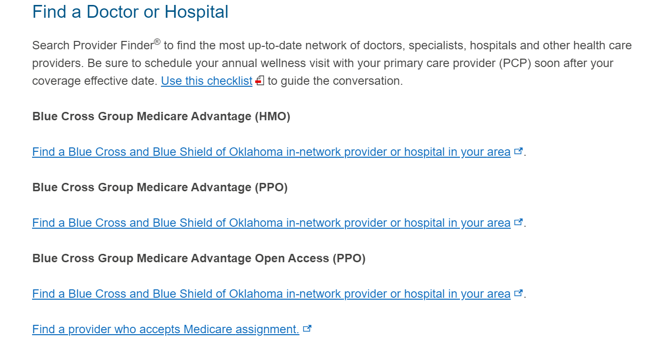
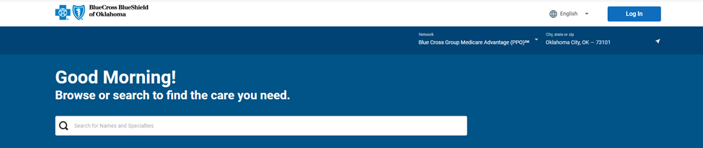
Provider Finder
Go to www.bcbsok.com/retiree-medicare-tools
Scroll down to the Find a Doctor or Hospital section
Select the link under Blue Cross Group Medicare Advantage (PPO)
The Provider Finder will open in a new tab
Search for in-network providers by name, specialty or location

Slide 25
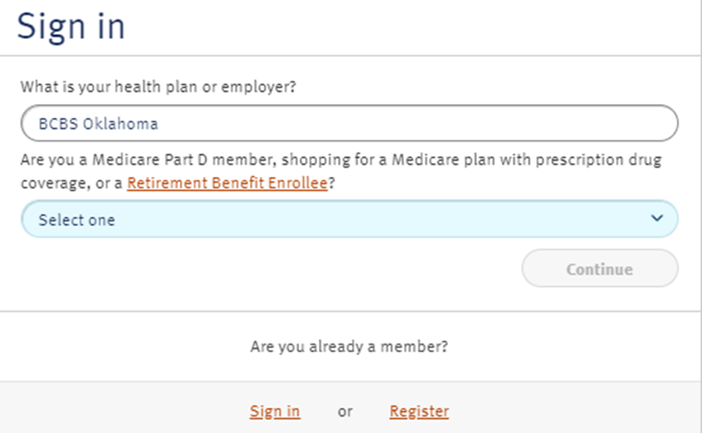
Formulary and Pharmacy Finder
Go to www.bcbsok.com/retiree-medicare-tools
Select Drug Finder Tool
Enter your health plan, plan type and drug list*
4. The Drug Finder will open in a new tab

Slide 26
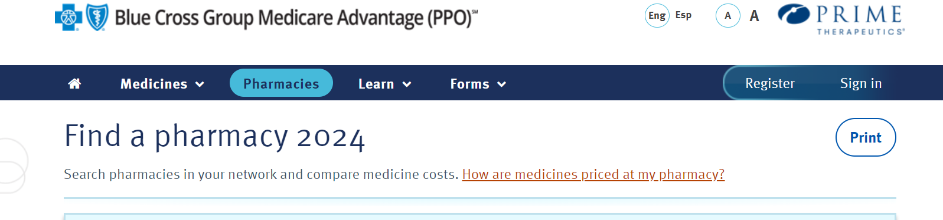
Formulary and Pharmacy Finder – Continued
5. To access a formulary, select the Medicines tab in the top navigation
>Scroll down to the documents section to find the Comprehensive Formulary link
6. To find a pharmacy, select the Pharmacies tab at the top navigation
>Select the type of Pharmacy (retail, preferred retail, mail order, etc.) and search by ZIP, city and state, or address

Slide 27

Member ID Cards
Card Needs | PDP | Blue Cross Group Medicare Advantage (MA)
Member Cards Needed | Blue Cross Group MedicareRx (PDP) | Blue Cross Group Medicare Advantage ID Card
Hospital / Doctor Visits | N/A | Blue Cross Group Medicare Advantage ID Card
Pharmacy / Prescription Needs | Blue Cross Group MedicareRx (PDP) | N/A
ID cards will be mailed to members by mid-December.

Slide 28

Next Steps
Continue to carefully review the materials you have received
Use resources provided by OKHEEI and BCBSOK:
Call the Education Helpline at 1-877-842-7564 TTY 711 with questions
Billing and Premium questions: Contact Makenzie Cross at HRPro at 1-248-556-7974 or mcross@hrpro.com.
Submit your completed Open Enrollment application between 11/1 -11/30/2025.
No action is required from employees unless changes to coverage or dependent information are needed.
Current medical plan selections will automatically carry over to the new carrier.

Slide 29
Member Communications Welcome Kits
Blue Cross and Blue Shield of Illinois, a Division of Health Care Service Corporation, a Mutual Legal Reserve Company, an Independent Licensee of the Blue Cross and Blue Shield Association
(Representative Samples Shown)

Slide 30

MA Welcome Kit
Welcome Kits will be mailed to new enrollees in mid to late December.
The kit includes the following:
Welcome Brochure | Information about how to use the Plans and details about benefit coverage
Star Rating | Star Ratings inform members on the Plan’s performance across CMS evaluation criteria
Directory Notice | Member instructions for accessing Plan documents online that includes Provider and Pharmacy directory and an EOC Notice
ND Multi Language Insert | Informs on the availability of language assistance services

Slide 31

PDP Welcome Kit
Welcome Kits will be mailed to new enrollees in mid to late December.
The kit includes the following:
Welcome Brochure | Information about how to use the Plans and details about benefit coverage
Star Rating | Star Ratings inform members on the Plan’s performance across CMS evaluation criteria
Directory Notice | Member instructions for accessing Plan documents online that includes Provider and Pharmacy directory and an EOC Notice
ND Multi Language Insert | Informs on the availability of language assistance services

Slide 32


Ongoing Communication
Once you are a member, your plan becomes your partner in health.
We’ll send helpful health reminders for preventive actions such as immunizations and screenings throughout the year.
We’ll also send you holiday, birthday and courtesy cards as we continue to stay connected.
If you have a special medical condition, you may receive personalized communication from our medical professionals who can help you manage your health and find resources just for you.

Slide 33
Disclaimers
Blue Cross and Blue Shield of Illinois, a Division of Health Care Service Corporation, a Mutual Legal Reserve Company, an Independent Licensee of the Blue Cross and Blue Shield Association

Slide 34
Important Plan Information
Blue Cross®, Blue Shield® and the Cross and Shield Symbols are registered service marks of the Blue Cross and Blue Shield Association, an association of independent Blue Cross and Blue Shield Plans.
Prescription Drug Plan Disclaimer: Prescription drug plans provided by Blue Cross and Blue Shield of Oklahoma, which refers to Health Care Service Corporation, a Mutual Legal Reserve Company (HCSC), an Independent Licensee of the Blue Cross and Blue Shield Association. A Medicare-approved Part D sponsor. Enrollment in HCSC's plans depends on contract renewal.
Medicare Advantage Plan Disclaimer: HMO plans provided by Blue Cross and Blue Shield of Oklahoma, which refers to GHS Health Maintenance Organization, Inc. d/b/a BlueLincs HMO (BlueLincs). HMO and PPO employer/union group plans provided by Health Care Service Corporation, a Mutual Legal Reserve Company (HCSC). HCSC and BlueLincs are Independent Licensee of the Blue Cross and Blue Shield Association. HCSC and BlueLincs are Medicare Advantage organizations with a Medicare contract. Enrollment in HCSC’s and BlueLincs’ plans depends on contract renewal.
Blue365: Blue365 is a discount program only for BCBSOK members. This is NOT insurance. Some of the services offered through this program may be covered under your health plan. Employees should check their benefit booklet or call the Customer Service number on the back of their ID card for specific benefit facts. Use of Blue365 does not change monthly payments, nor do costs of the services or products count toward any maximums and/or plan deductibles. Discounts are only given through vendors that take part in this program. BCBSOK does not guarantee or make any claims or recommendations about the program’s services or products. Members should consult their doctor before using these services and products. BCBSOK reserves the right to stop or change this program at any time without notice. Healthy Activity Portal: The Healthy Activity Portal is a website owned and operated by HealthMine, Inc., an independent company that has contracted with Blue Cross and Blue Shield of Oklahoma to provide digital health and personal clinical engagement tools and services for members with coverage through BCBSOK. BCBSOK makes no endorsement, representations or warranties regarding third-party vendors and the products and services offered by them. Registration is required to participate. Visit www.BlueRewardsOK.com to register and see what Healthy Actions earn rewards. Maximum annual rewards of $100 in gift cards. One reward per Healthy Action per year. Healthy Action dates of service must be in the current plan year. Healthy Actions that earn rewards are subject to change.

Slide 35
Important Plan Information
MDLIVE: Virtual Visits may not be available on all plans. Non-emergency medical service in Montana and New Mexico is limited to interactive online video. Non-emergency medical service in Arkansas and Idaho is limited to interactive online video for initial consultation. MDLIVE is a separate company that operates and administers Virtual Visits for Blue Cross and Blue Shield of Illinois. MDLIVE is solely responsible for its operations and for those of its contracted providers. MDLIVE® and the MDLIVE logo are registered trademarks of MDLIVE, Inc., and may not be used without permission. MyPrime.com is a pharmacy benefit website owned and operated by Prime Therapeutics LLC, a separate company providing pharmacy solutions for your plan.
SilverSneakers: Blue Cross®, Blue Shield® and the Cross and Shield Symbols are registered service marks of the Blue Cross and Blue Shield Association, an association of independent Blue Cross and Blue Shield Plans. SilverSneakers® is a wellness program owned and operated by Tivity Health, Inc., an independent company. Tivity Health and SilverSneakers® are registered trademarks or trademarks of Tivity Health, Inc., and/or its subsidiaries and/or affiliates in the USA and/or other countries.
TruHearing: TruHearing® is a registered trademark of TruHearing, Inc., which is an independent company providing discounts on hearing aids.
Translation Services
We have free interpreter services to answer any questions you may have about our health or drug plan. To get an interpreter, just call us at 1-877-774-8592 TTY 711. Someone who speaks English/Language can help you. This is a free service. ​
Tenemos servicios de intérprete sin costo alguno para responder cualquier pregunta que pueda tener sobre nuestro plan de salud o medicamentos. Para hablar con un intérprete, por favor llame al 1-877-774-8592 TTY 711. Alguien que hable español le podrá ayudar.
Este es un servicio gratuito.

Slide 36
Thank you for attending today’s educational session.

