Slide 1
Strategic Goal Two
Co-Chairs: Ruth Boyd, Vicki Hatton
Members: Daniel Archer, Randy Beckloff, Kim Cook, Tom Davis, Trevor Ellis, Judy Haught, Andrea Holgado, Robin Jones, Taylor Kincanon, Scott Miller, Frederic Murray, Bo Pagliosotti,

Slide 2
Focus on Academic Quality through accessible, innovative, and high quality academic programs that are based on student needs and those of the region and the state.

Slide 3
Strategic Goal Two
1. Establish an interdisciplinary honors program that serves 200-250 students or 5% of SWOSU enrollment.

Slide 4
Report from Honors Committee
Honors Committee - A full report has been submitted to the Goal 2 Committee for review.
Upon presentation to this committee, it will be forwarded to SWOSU administrators.

Slide 5
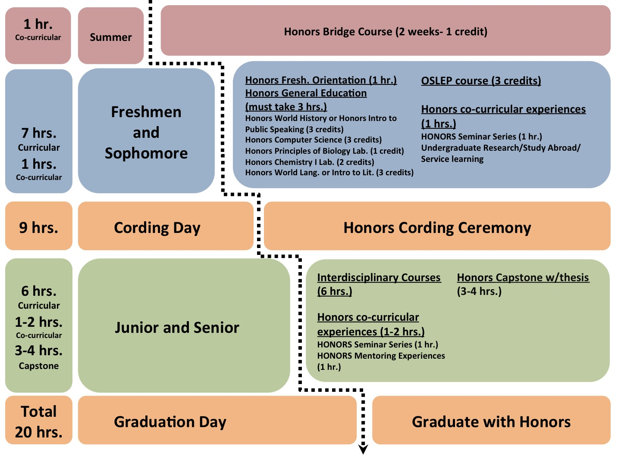
Excerpts:

Slide 6
8 credit hours earned during freshman/sophomore years
Summer Bridge Course (1 credit hour)
Honors Freshman Orientation (1 credit hour)
General Education Honors courses (3 credit hours).
One OSLEP (Oklahoma Scholar-Leadership Enrichment Program) course (3 credit hours).

Slide 7
12 credit hours earned during junior/senior years
6 credit hours Curricular
1-2 credit hours Co-curricular
3-4 credit hours Capstone

Slide 8
Strategic Goal Two
2. Have a revised general education program to equip students for a rapidly evolving world.

Slide 9
Report from General Education Committee
Have sought input from department chairs and program directors.
Data compiled and discussed. Committee work is ongoing/in progress.

Slide 10
OSRHE Requirements
(minimum 40 hours)
English Composition 6 hours
U.S. History & U.S. Government 6 hours
Science 6 hours
(at least one laboratory course)
Humanities 6 hours
Mathematics 3 hours
One course from Psych, Soc. Sci.,
Foreign Lang, or Fine Arts 3 hours

Slide 11
Strategic Goal Two
3. Have an academic environment that fosters innovation through experimentation with and adoption of “high impact” and the “best” educational practices.

Slide 12
High Impact/Best Practices
First-Year Seminars and Experiences
  Suggested Action: Modeled after PLC format, engagement of students, social media
Learning Communities
  Suggested Action: Collaboration between faculty members from various departments in both remedial and general education courses.
Collaborative Assignments
  Team teaching between disciplines, as suggested by the Inter-professional Education Committee.

Slide 13
High Impact/Best Practices
Undergraduate Research
  Suggested Action: Increase financial assistance, identify and implement a mechanism for release time, clarification of effect on promotion and tenure process.
Diversity & Global Learning
  Suggested Action: Designate the International Student Affairs Office as the information center for opportunities to study abroad & continue international university exchange agreements.

Slide 14
High Impact/Best Practices
Service Learning
  Suggested Action: Continued support of existing SL initiatives and the SL mission statement.
Internships
  Suggested Action: Specific internship handbooks, maintenance of contact lists, internship objectives clearly defined between stakeholders, consistent communication between students & supervisors.

